Slide 1
Swift Workshop

Slide 2
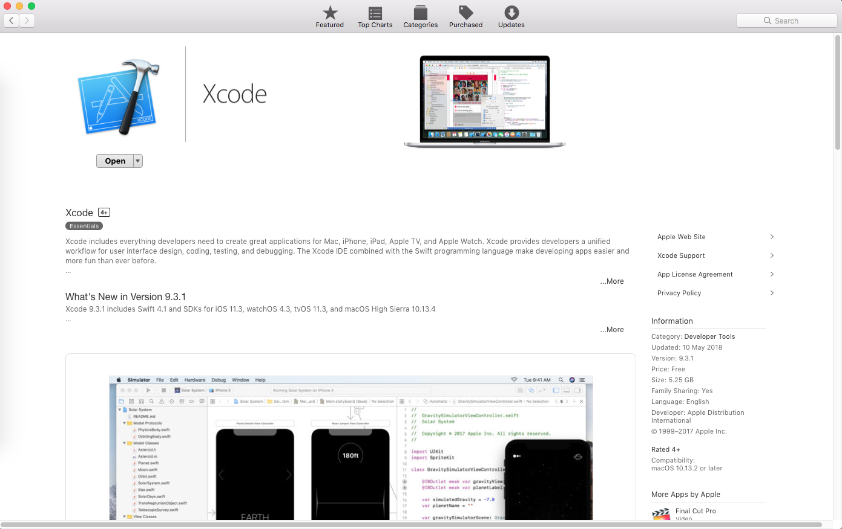
Install XCode

Slide 3
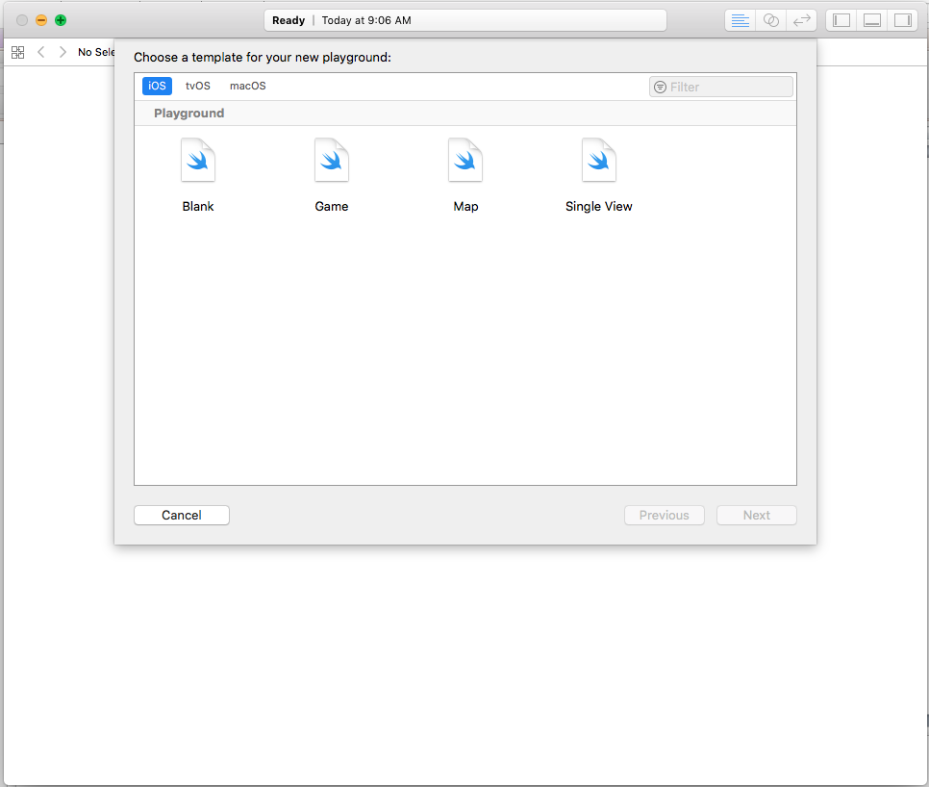
Running Swift on Playground

Slide 4
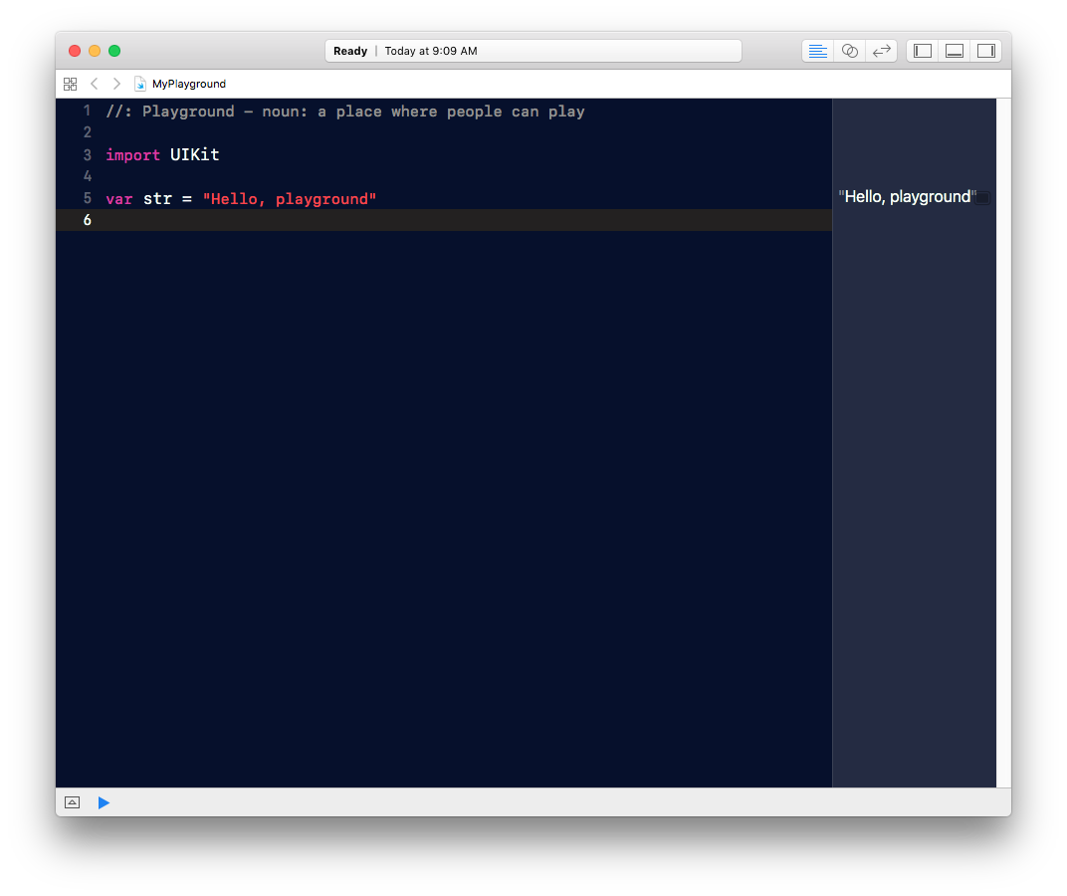
Swift Playground

Slide 5
Let’s begin coding!

Slide 6
Variable and Constant
variable: var
constant: let

Slide 7
Example of variables
var a = 5
a = 6
a = 6.5 (Error)
It’s expecting a value of type Int

Slide 8
Example of Constants
let a = 5
a = 6 (Error)

Slide 9
Printing on console
var a = 4
var b = 6
var c = a + b
print(“\(a) + \(b) = \(c)”)
print(“\(a) + \(b) = \(a+b)”)

Slide 10
Comments
// Single-line comment
/*
A multi-line comment
Line 1 comment
Line 2 comment
*/

Slide 11
DATA TYPES

Slide 12
Data Types
Integer
Floating Point
Boolean
String
Character
Any

Slide 13
Integer and Floating Number

Slide 14
Integer
var a = 39
var b: Int = 50
var one, two, three: Int
one = 1
two = 2
three = 3

Slide 15
Floating point
var a = 50
var b = 4.8
var c: Double
c = Double(a) + b
Now try c = a + b

Slide 16
Boolean
let a: Bool = true
let b: Bool = false
a || b
a && b

Slide 17
String
Swift uses double quotes (“…”) for string, and not single quote (‘…’)
Example
var a = “Hello”
var b = “World”

Slide 18
Concatenating Strings
let a = “Hello”
let b = “ World”
var c = a + b

Slide 19
String Transform
a.uppercased()
b.lowercased()

Slide 20
Challenge: String
let country = “malaysia”
let capital = “KUALA LUMPUR”
print out ->
The capital of FRANCE is paris
Time: 2 min

Slide 21
Search String
var a = “Hello World”
if a.range(of: “World”) != nil {
print(“It Exists”)
}

Slide 22
Challenge: String
let website = “www.google.com”
search the website for http://, if not exist, replace the website with http:// prefix
Example
website = “http://www.apple.com”
Time: 5 min

Slide 23
Solution to Challenge
let website = “www.google.com”
if website.range(of: “http://”) == nil {
website = “http://\(website)”
}

Slide 24
Replace String
var a = “Hello World”
var b = a.replacingOccurences(of: “World”, with: “Marcus”)

Slide 25
Optional
An optional value either contains a value or nil (no value) to indicate that a value is missing
var a: Int?
print(a) //Optional(nil)
a = 5
print(a) //Optional(5)

Slide 26
Unwrapping Optional
To get the underlying type from an optional variable, you can unwrap it using the unwrap operator (!)
var a: Int?
a = 5
print(a) //Optional(5)
print(a!) //5

Slide 27
Common errors with Optional
var a: Int?
var b: Int
a = 4
b = a + 1
b = a! + 1
var a : String? = “Hello”
print(a.uppercased()) (Error)
print(a!.uppercased())

Slide 28
Any
var a:[Any] = [4,5.6, “Hi”]

Slide 29
Collection Types

Slide 30
Collection Types
Swift provides four primary collection types:
Array: ordered collections of values
Set: unordered collections of unique values
Dictionary: unordered collections of key-value associations
Tuple: ordered collection of different types

Slide 31
Define Array
var a = [1,2,3]
var a = [“Alison”, “Brenda”, “Jennifer”]

Slide 32
Append Element
var a = [1,6,7]
a.append(2)

Slide 33
Adding 2 Arrays
var a = [1,2,3,4]
var b = [5,6,7,8]
a + b

Slide 34
Access Array Elements
var a = [5,4,6,7,2,8,10]
a[2]
a[2..<5]
a[2...6]
a.first
a.last

Slide 35
Insert & Remove Elements
var a = [5,4,6,7,2,8,10]
a.insert(100, at:1)
a.remove(at:1)

Slide 36
Sort
var a = [5,4,6,7,2,8,10]
a.sort()
a.sorted(by:>)
var n = a[0..<2].sorted(by:>)

Slide 37
Define a Set with Elements
var a: Set = [“Brenda”, “Alison”, “Jennifer”]

Slide 38
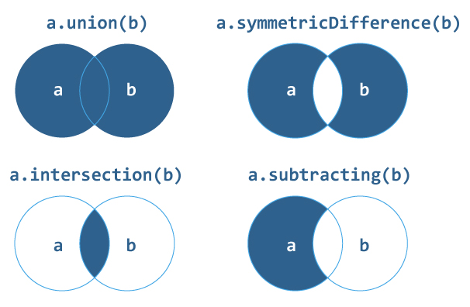
Set Operations

Slide 39
Set Operation Examples
var a:Set = [3,4,5]
var b:Set = [6,5,8,13,2]
a.union(b)
a.intersection(b)
a.subtract(b)
b.subtract(a)

Slide 40
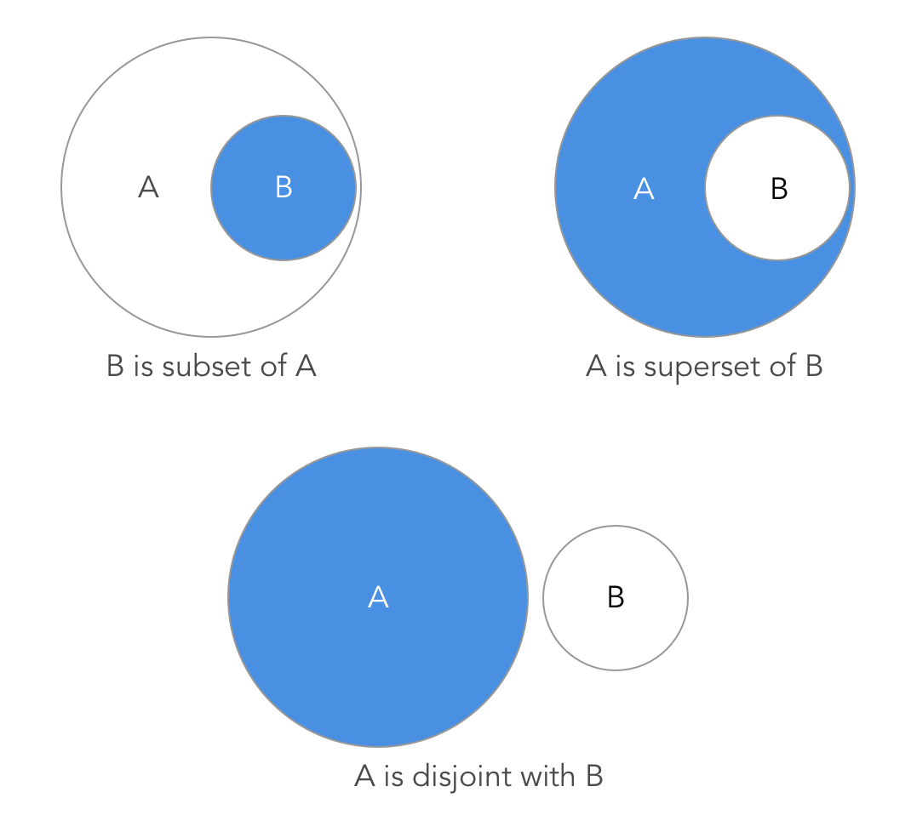
Set Membership

Slide 41
Set Membership Examples
var a:Set = [“Brenda”, “Alison”, “Jennifer”]
var b:Set = [“Jovi”, “Brenda”, “Alison”, “Steph”]
var c:Set = [“Jane”]
a.isSubset(of: b)
b.isSuperset(of: a)
a.isDisjoint(with: c)

Slide 42
Add and Remove Set Element
a.insert[“Jovi”]
a.remove[“Alison”]
a.removeAll()

Slide 43
Define Dictionary
var a = [“alice”:160, “brenda”:170]
a[“brenda”]

Slide 44
Tuple
var a: (String, Int, Int, Double)
a = (“alice”, 40, 170, 50.8)
a.0
a.1
a.2
a.3

Slide 45
Tuple with Name
var a: (name:String, age:Int, height:Int)
a = (“alice”, 40, 170)
a.name
a.age
a.height

Slide 46
Operators

Slide 47
Arithmetic Operators
Addition +
Subtraction -
Multiplication *
Division /
Modulus %

Slide 48
Compound Operators
Addition +=
Subtraction -=
Multiplication *=
Division /=
Modulus %=

Slide 49
Comparison Operators
equal ==
greater than >
less than <
greater or equal >=
less or equal <=
not equal !=

Slide 50
Logical Operators
and &&
or ||
not !

Slide 51
Range Operators
1...10 //include 10
1..<10 //exclude 10
Used in array indexing. For example, a[1…10] and for loop, i in 1…3 {…}

Slide 52
Control Flow

Slide 53
Conditional

Slide 54
Conditional Types
There are 3 types of conditional (branch) control in Swift
if-else-if
guard-else
switch-case

Slide 55
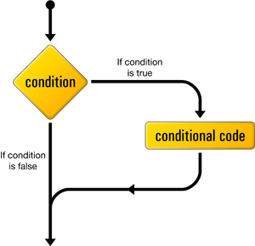
If Statement

Slide 56
If Syntax
if condition {
statements
}

Slide 57
If Statement example
var a = 10
var b = 20
if (a < b) {
print(“a is smaller than b”)
}

Slide 58
If-Else Syntax
if condition {
statements to execute if condition is true
} else {
statements to execute if condition is false
}

Slide 59
If-Else example
var a = 10
var b = 20
var c
if (a < b) {
c=b
print(“a is smaller than b”)
} else {
c=a
print(“a is larger than b”)
}

Slide 60
Ternary Operator
condition ? do this: else do this
var c = (a < b) ? a : b

Slide 61
If-Else-If Syntax
if (1st condition) {
statements to execute if condition 1 is true
} else if (2nd condition){
statements to execute if condition 2 is true
} else {
statements to execute if both conditions are false }

Slide 62
If-Else-If Example
if a < b {
print(“a is smaller than b”)
}
else if a > b {
print(“a is larger than b”)
}
else {
print(“a is same as b”)
}

Slide 63
Guard-Else Syntax
A guard statement is used to transfer program control out of a scope if one or more conditions aren’t met.
guard condition else {
statements
..
..
}

Slide 64
Guard-Else in Function
var a:Int?
a = 5
func f(x:Int?) {
guard let b = x else {
return
}
print(“exist”)
}
f(x: a)

Slide 65
Switch Case Syntax
switch control expression {
case pattern 1:
do something…
case pattern 2:
do something…
case pattern 3, pattern 4:
do something..
default:
do something…
}

Slide 66
Switch Case Example
let a = 7
switch a {
case 1...3:
print(“low value”)
case 4...6:
print(“high value”)
default:
print(“this is impossible”)
}

Slide 67
Challenge: Switch
grade = “A”
if grade is A, print Excellent
if grade is B, print Well Done
if grade is C, print Work Harder
Time: 5 mins

Slide 68
Solution for Switch
let grade = “A"
switch grade {
case "A":
print("Excellent")
case "B":
print("Well Done")
case "C":
print("Work Harder")
default:
print("What grade is this?")
}

Slide 69
Loop

Slide 70
Loop Types
There are 3 types of Loop in Swift
for
while
repeat

Slide 71
For-in Syntax
for var i in collection {
//do something here
}

Slide 72
For-in Loop over a range
for i in 1...10 {
print(i*i)
}
by default this always increments by 1

Slide 73
Continue
for i in 1...10 {
if i == 3 {continue}
print(i*i)
}

Slide 74
Break
for i in 1...10 {
if i == 3 {break}
print(i*i)
}

Slide 75
Challenge: for loop
Generate an array of 10 Square Numbers and remove those numbers divisible by 3
Answer: [1, 4, 16, 49, 64, 100]
Time: 10 mins

Slide 76
Hint for Challenge
if i%3 == 0 {
continue;
}

Slide 77
While Loop Syntax
while (condition) {
// do something
}

Slide 78
While Loop Example
var i = 1
while (i < 10) {
print(i)
i = i+1
}

Slide 79
Function

Slide 80
What is Function?
Functions are block of code that enable
Reusability
Breaking complex solutions into simpler steps
Simplifies the debugging process
Eases the processes of updating and improving code

Slide 81
Function Syntax
func function_name(arg1: Type..) -> Type {
// Enter code here
return values
}

Slide 82
Function Example
func hello() {
printf(“Hello”)
}

Slide 83
Input Argument
func f(x:Float) -> Float {
return x*x
}
f(x:2)

Slide 84
Skip Argument Name
func f(_ x:Float) -> Float {
return x*x
}
f(2)

Slide 85
Multiple Arguments
func f2(x: Float, y:Float, z:Float) -> Float {
return x*x + y*y + z*z
}
f2(x:2, y:2, z:3)

Slide 86
Default Values
func f(x:Double = 1, y:Double = 5) -> Double {
return x*x + 3*y
}
f()

Slide 87
Challenge: Function
Create a function for area of triangle with two inputs:
Base
Height
Area = 0.5 x Base x Height
Time: 5 mins

Slide 88
Answer: Challenge
func area(base:Double, height:Double) -> Double {
return 0.5 * base * height
}
area (base: 10, height: 10)

Slide 89
Class

Slide 90
Object Oriented Programming
Objects are created from template
Template is defined by class

Slide 91
Class Syntax
class Name {
//class definition goes here
}

Slide 92
Class Example 1
class Rectangle {
var length:Int = 3
var height:Int = 4
func area() -> Int {
return length*height
} }
var rect = Rectangle();
rect.area()

Slide 93
Class Example 2
class Person {
var height = 0;
var name = “”
func talk() {
print(“talk like a person”)
}
}

Slide 94
Challenge: Class
Create a Counter class that has the following property count starting at 0 and the methods
increment
incrementBy
reset
Time: 10 min

Slide 95
Hint to challenge
class Counter {
var count = 0;
func increment() {
count += 1;
}
}

Slide 96
Answer : Challenge
class Counter {
var count = 0;
func increment() {
count += 1;
}
func incrementBy(_ x:Int) {
count = count + x
}
func reset() {
count = 0
}
}
var counter = Counter()
counter.increment()
print(counter.count)
counter.incrementBy(20)
print(counter.count)
counter.reset()
print(counter.count)

